Slide 1
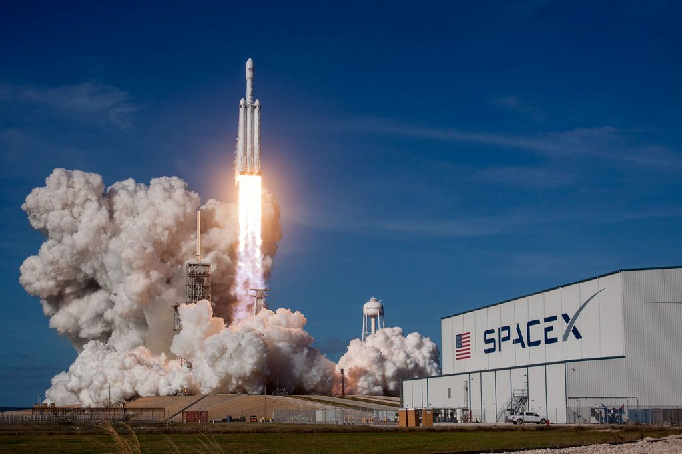

Space Race with Falcon X
Phuc Thinh Nguyen
June 20th, 2024

Slide 2
Outline
Executive Summary
Introduction
Methodology
Results
Conclusion
Appendix

Slide 3
Executive Summary
Summary of methodologies
From an API
Using Plotly Dash
From web scraping
Using Folium
Data collection
Interactive Visuals
Predictive Analysis
Using Machine Learning
Data wrangling
Exploratory Data Analysis
Using SQL
Using Pandas,
Matplotlib

Slide 4
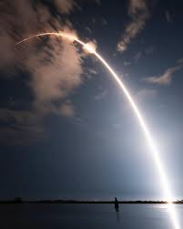
Executive Summary
Summary of all results
Exploratory Data Analysis Results
Data Visualizations Results
Interactive Visual Dashboard Results
Predictive Analysis Results

Slide 5
Introduction
Project background and context
Predict if the Falcon 9 first stage will land successfully
to determine the cost of a launch
Problems that need answers
Will payload mass and launch sites of the rocket have any relationships with its success rate?
Do the distances of the launch sites from its neighbors important?
What machine learning tools will we use to predict the success rate?

Slide 6
Methodology
Phuc Thinh Nguyen
June 20th, 2024

Slide 7
Methodology
Data collection using API
Using pre-defined helper functions
Using json.normalize()
Get the URL of past SpaceX launches from SpaceX API
Transform the data into a Python DataFrame
Filter the dataframe to needed columns
Get the needed data from the API to the filtered dataframe
Using GET request
Replace missing values in “Payload Mass” data with the mean
Filter the dataframe to only need Falcon 9 launches
A dataframe with columns:
FlightNumber, Date, BoosterVersion, PayloadMass, Orbit, LaunchSite, Outcome, Flights, GridFins, Reused, Legs, LandingPad, Block, ReusedCount, Serial, Longitude, Latitude
GitHub: Data Collection API

Slide 8
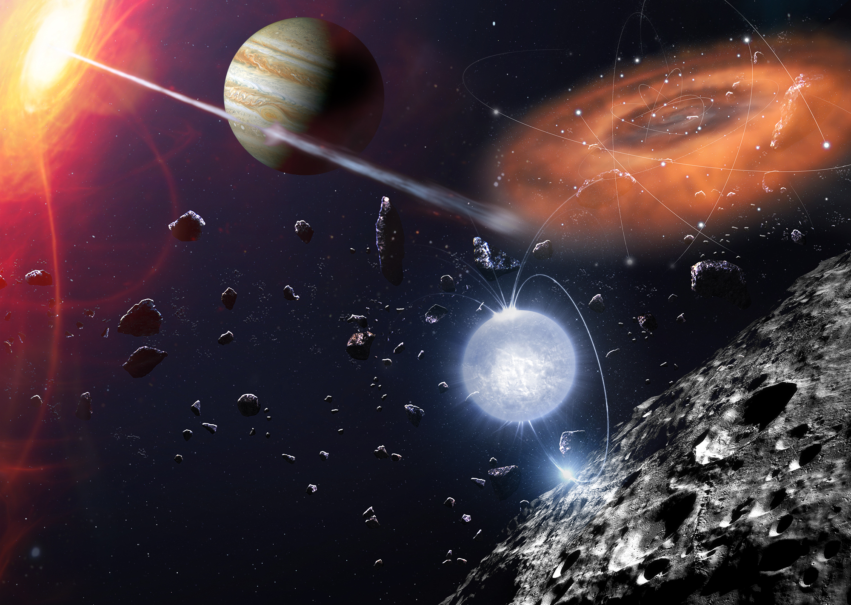
Methodology
Data collection using web scraping
Using pre-defined helper functions
Using BeautifulSoup
Get the HTML format of past SpaceX launches from Wikipedia
Get the column name
Parsing the HTML file to extract needed data
Create a dataframe from the previous extraction
Using GET request
Export data to CSV
A dataframe with columns:
'Flight No.', 'Date and time ( )', 'Launch site', 'Payload', 'Payload mass', 'Orbit', 'Customer', 'Launch outcome’
GitHub: Data Collection Web Scraping

Slide 9

Methodology
Data wrangling
Calculate the number of launches on each launch site
Calculate the number and occurrence of each orbit
Calculate the number and occurrence of mission outcome of the orbits
Load the dataset
Identify null values
Identify numerical and categorical variables
Label bad outcome as 0 and good outcome as 1
A dataframe with outcomes:
True/False Ocean: whether or not the rocket successfully landed on a region in the ocean
True/False RTLS: whether or not the rocket successfully to a ground pad
True/False ASDS: whether or not the rocket successfully landed on a drone ship
GitHub: Data Wrangling

Slide 10

Methodology
EDA with Visualizations
Visualize the relationship between two variables
Visualize the relationship between categorical variables through its frequency
Scatter
plot
Bar
chart
Line plot
Visualize the relationship of a single variable over time
GitHub: EDA with Data Visualizations

Slide 11

Methodology
EDA with SQL
• Get unique launch sites
• Get records where launch sites begin with ‘CCA’
• List the total number of successful and failure mission outcomes
• Get total payload mass carried by boosters launched by NASA (CRS)
• List booster versions which have carried the maximum payload mass
• Get average payload mass carried by booster version F9 v1.1
• List the records with months, failure landing outcomes in drone ship, booster versions, launch site for the months in year 2015.
• Get the first successful landing outcome date in ground pad
• Rank in descending order the count of landing outcomes between the date 2010-06-04 and 2017-03-20
• Get boosters which have success in drone ship and have payload mass greater than 4000 but less than 6000
GitHub: EDA with SQL

Slide 12




Methodology
Interactive Map With Folium
GitHub: Interactive Map with Folium
Marker: identify the launches with success rate (green means success, red means failure)
NASA
JSC
Circle: specify the highlighted area with given coordinates
Line: specify the distance from the launch site to the closest railway, highway, city
10000 miles

Slide 13
Methodology
Dashboard with Plotly Dash
Pie plot: illustrate the total success launches for each sites
Drop-down: allows the user to choose the launch site they want information from
Slider: provides the information of the range of payload mass to be displayed
Scatterplot: gives information of the payload mass range of all launch sites, with its success status
GitHub: Plotly Dash Python Source Code

Slide 14
Methodology
Predictive Analysis (Classification)
Create a NumPy array (Y) of labeled targets and standardize the data (X) with remaining variables
Import libraries and define a function to plot the confusion matrix
Split X and Y into training sets and test sets
Create a GridSearchCV object with cv = 10
Apply GridSearchCV to different machine learning algorithms
Calculate the accuracy of the machine learning models and plot the confusion matrix
Logistic Regression
Decision Tree
Determine the best model (Decision Tree)
K-Nearest Neighbors
SVM
GitHub: Predictive Analysis (Classification)

Slide 15

Methodology
Results
Exploratory Data Analysis Results
Interactive Analytics Demo in Screenshots
Predictive Analysis Results

Slide 16
Insights Drawn From EDA
Phuc Thinh Nguyen
June 20th, 2024

Slide 17

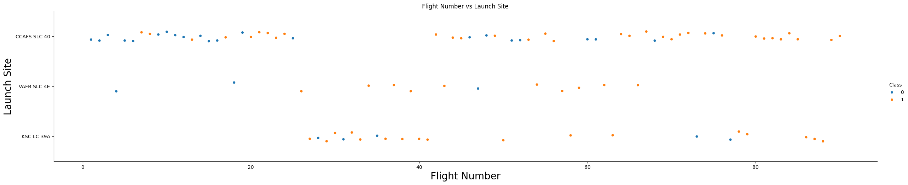
Insights Drawn From EDA
Flight Number vs. Launch Site
• Most of the flights are launched at CCAFS SLC 40.
• Most of the first flights are unsuccessful (blue), while most of the latest flights are successful (orange)
• VAFB SLC 4E and KSC LC 39A are launch sites with high success rate.

Slide 18
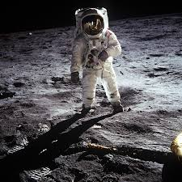
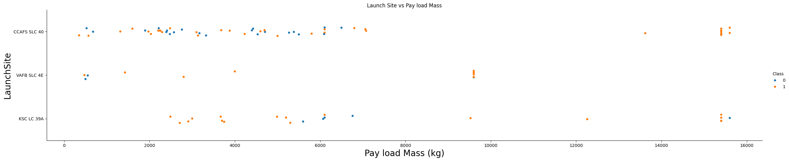
Insights Drawn From EDA
Payload Mass vs. Launch Site
• Most of the flights are launched at CCAFS SLC 40, with payload mass approximately ranging from 1000 – 7500kg.
• Most successful launches have payload mass at least approximately 9750kg.
• VAFB SLC 4E and KSC LC 39A are launch sites with high success rate.

Slide 19

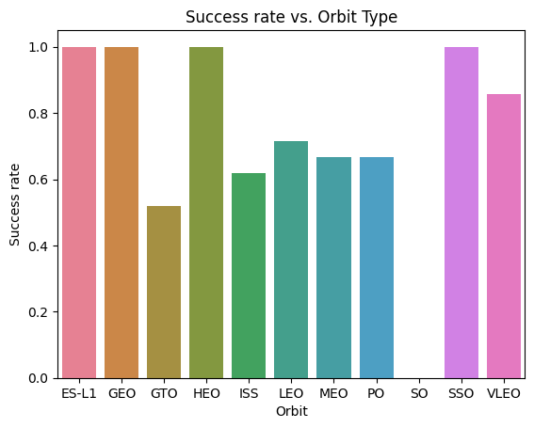
Insights Drawn From EDA
Success Rate vs. Orbit Type
• ES-L1, GEO, HEO, and SSO have 100% success rate.
• SO has 0% chance of having successful launches
• The remaining orbits have at least 50% chance of
success.

Slide 20

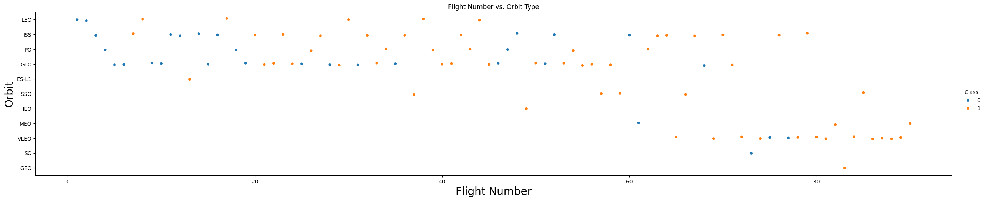
Insights Drawn From EDA
Flight Number vs. Orbit Type
• The most recent launches had a successful outcome, mostly with VLEO orbit type.
• Most flights in LEO orbit are successful.

Slide 21

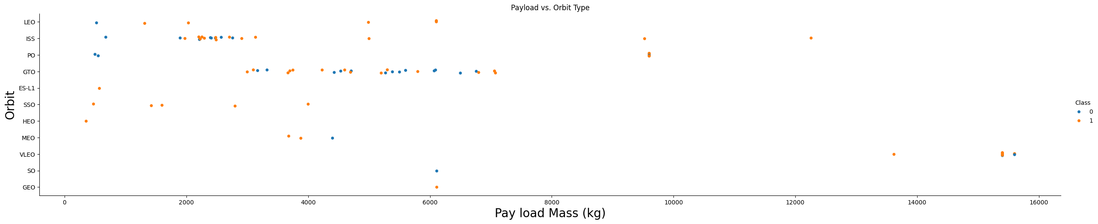
Insights Drawn From EDA
Payload vs. Orbit Type
• Heavy payload masses have more successful launches in LEO, PO, ISS, and VLEO orbits.
• Low payload masses have more successful launches in ES-L1, SSO, and HEO.

Slide 22
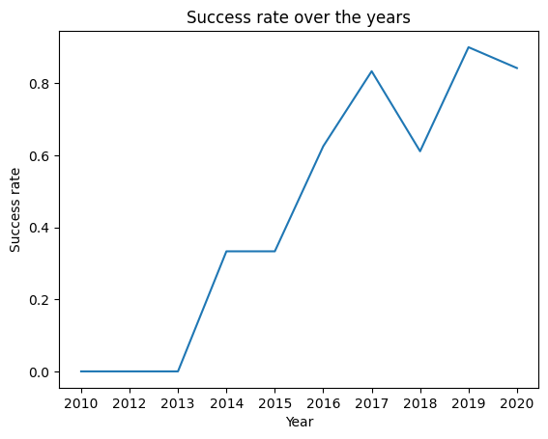
Insights Drawn From EDA
Launch Success Yearly Trend
• The success rate of the launches increases from 2013 until 2020, despite a decrease in 2018.

Slide 23

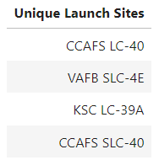
Insights Drawn From EDA
All Launch Site Names
• CCAFS LC-40, VAFB SLC-4E, KSC LC-39A, and CCAFS SLC-40 are the
names of the unique launch sites in the space mission.

Slide 24

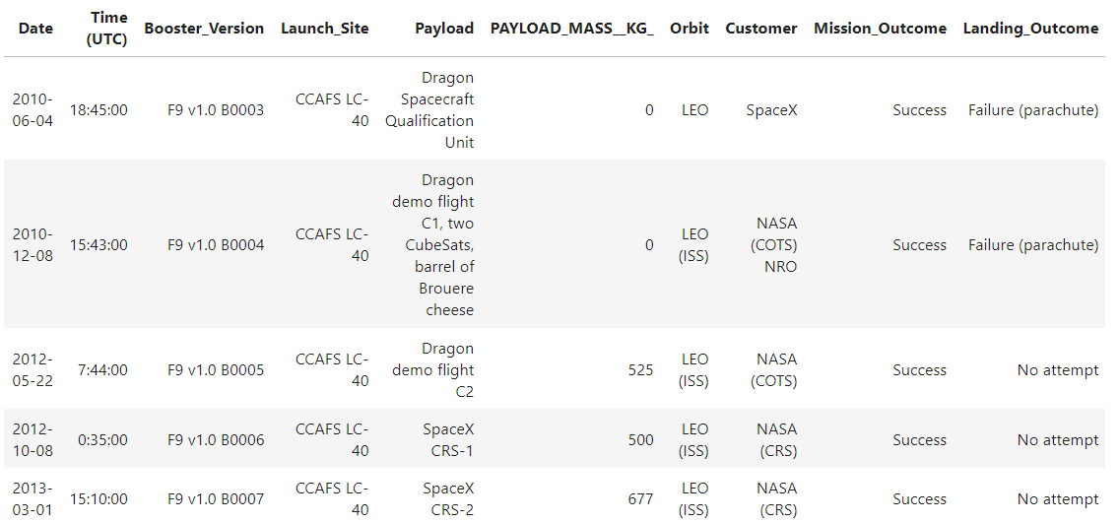
Insights Drawn From EDA
Launch Site Names Begin With ‘CCA’
• Above are 5 records where launch sites begin with the string 'CCA’

Slide 25
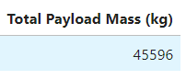
Insights Drawn From EDA
Total Payload Mass
• The total payload mass carried by boosters launched by NASA (CRS) is 45596kg

Slide 26

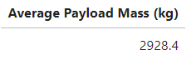
Insights Drawn From EDA
Average Payload Mass by F9 v1.1
• The average payload mass carried by booster version F9 v1.1 is 2928.4kg

Slide 27
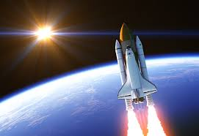
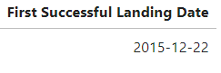
Insights Drawn From EDA
First Successful Ground Landing Date
• The date when the first successful landing outcome in ground pad was achieved is November 22nd, 2015.

Slide 28
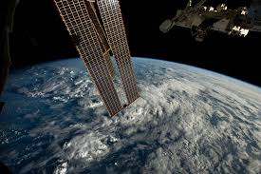
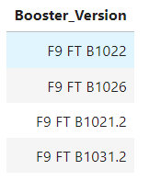
Insights Drawn From EDA
Successful Drone Ship Landing with Payload between 4000 and 6000
• F9 FT B1022, F9 FT B1026, F9 FT B1021.2, F9 FT B1031.2 are the names of the boosters which have success in drone ship and have payload mass greater than 4000 but less than 6000.

Slide 29

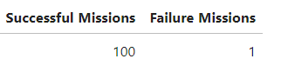
Insights Drawn From EDA
Total Number of Successful and Failure Mission Outcomes
• There are a total of 100 successful mission outcomes and 1 failure mission outcomes.

Slide 30

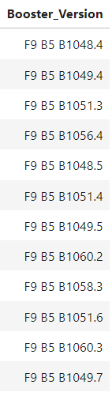
Insights Drawn From EDA
Boosters Carried Maximum Payload
• On the left are the names of the booster versions which have carried
the maximum payload mass.

Slide 31

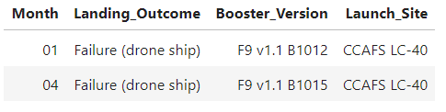
Insights Drawn From EDA
2015 Launch Records
In 2015:
• In January, a rocket launched from CCAFS LC-40 with booster version F9 v1.1 B1012 failed to land on a drone ship.
• In April, a rocket launched from CCAFS LC-40 with booster version F9 v1.1 B1015 failed to land on a drone ship.

Slide 32
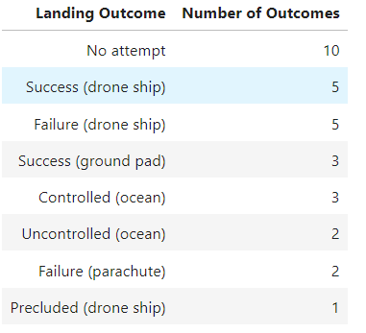
Insights Drawn From EDA
Rank Landing Outcomes Between 2010-06-04 and 2017-03-20
• On the left are the count of landing outcomes between April 6, 2010 and March 20th, 2017 in descending order. For example, there are 5 rocket launches that successfully landed on a drone ship.

Slide 33
Launch Sites Proximities Analysis
Phuc Thinh Nguyen
June 20th, 2024

Slide 34
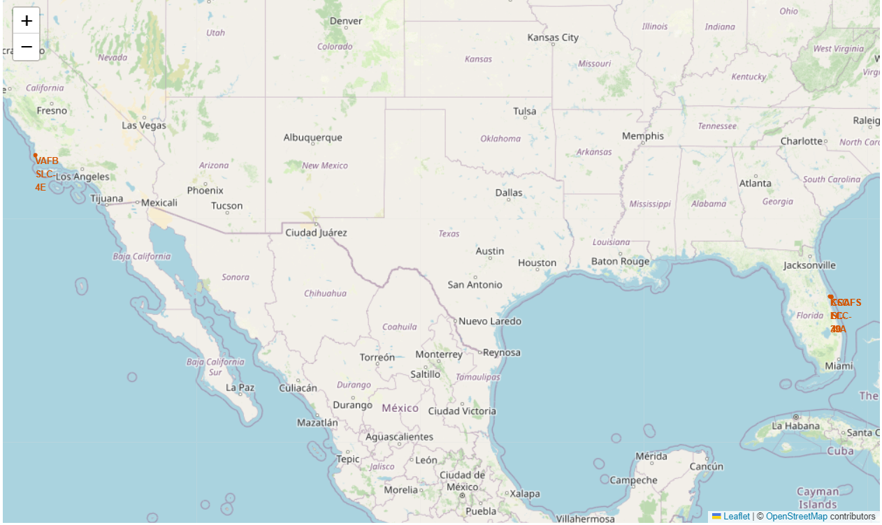
Insights Drawn From EDA
Rank Landing Outcomes Between 2010-06-04 and 2017-03-20
• All of the launches are in close proximity to the equator (0-degree orbit) so that less maneuver is needed, saving fuel and manufacturing cost.
• All of the launches are in very close proximity to the coast so that it stays away from the cities, highways, and railroads.

Slide 35

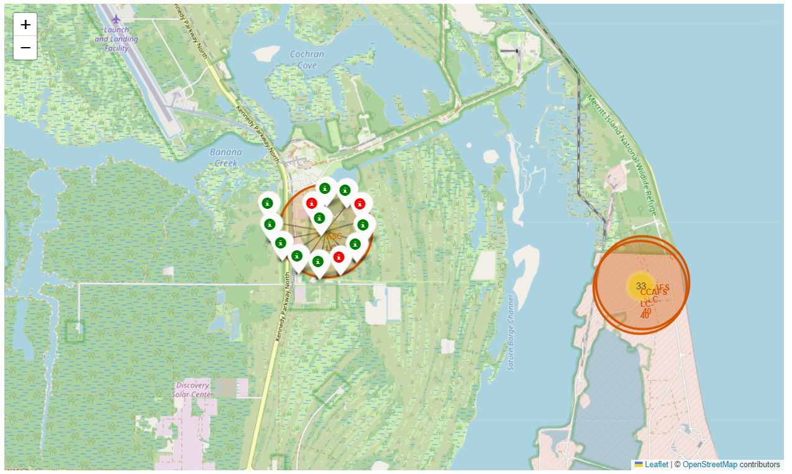
Insights Drawn From EDA
Folium Map of Color-Labeled Launch Outcomes
• The green markers shows successful launches, while red markers indicate failure outcomes.
• The map indicates that KSC-LC 39A has a high success rate.

Slide 36

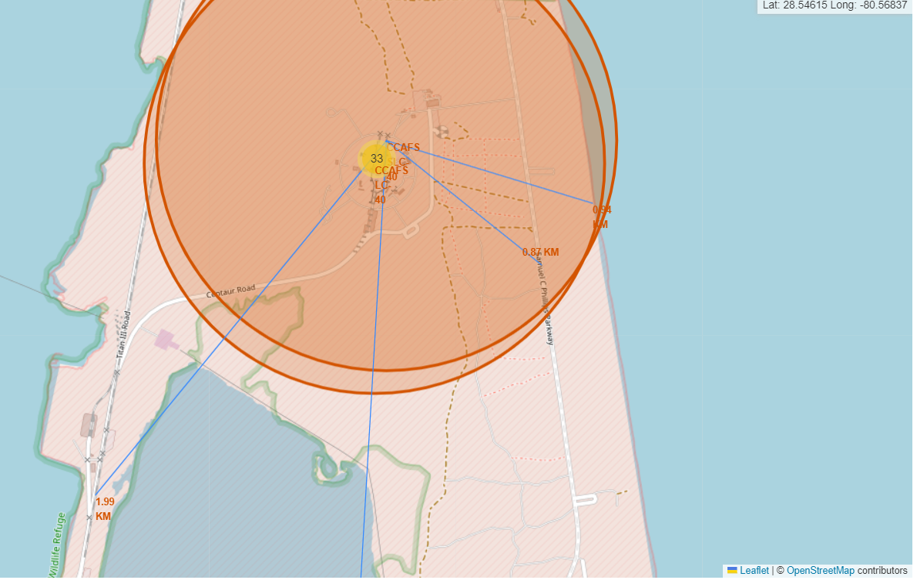
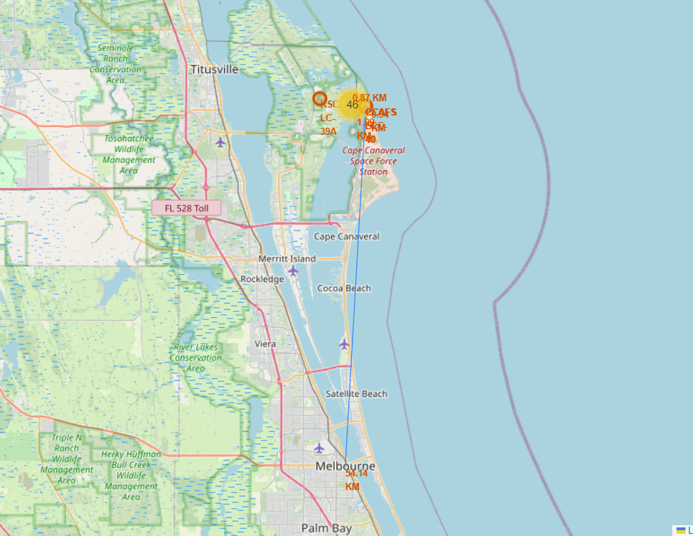
Insights Drawn From EDA
Folium Map of Distances From A Launch Site
• This map shows that CCAFS-LC 40 is:
(+) 0.94km away from the closest coastline
(+) 0.87km away from the closest road
(+) 1.99km away from the closest railroad
• This map shows that CCAFS-LC 40 is 54.14km from Melbourne, one of the closest cities, indicating that a failure outcome at the launch site would negatively affect nearby cities.

Slide 37
Dashboard with Plotly Dash
Phuc Thinh Nguyen
June 20th, 2024

Slide 38

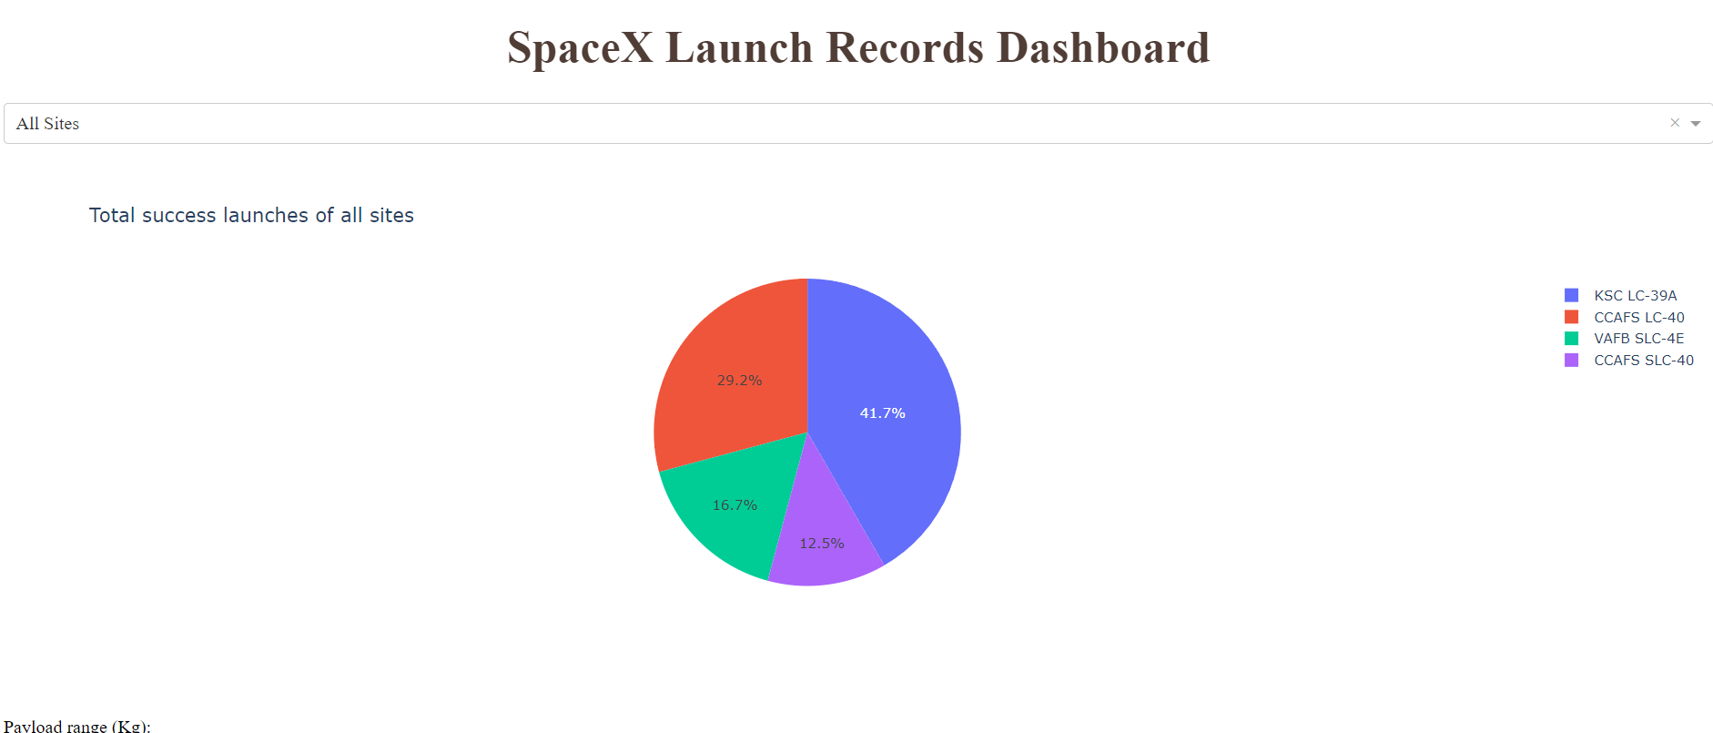
Insights Drawn From EDA
Plotly Pie Chart of Total Success Launches of All Sites
• The pie chart indicates that KSC LC-39A has the highest success launches rate (41.7%), followed by CCAFS LC-40 (29.2%), VAFB SLC-4E (16.7%), and CCAFS SLC-40 (12.5%)

Slide 39

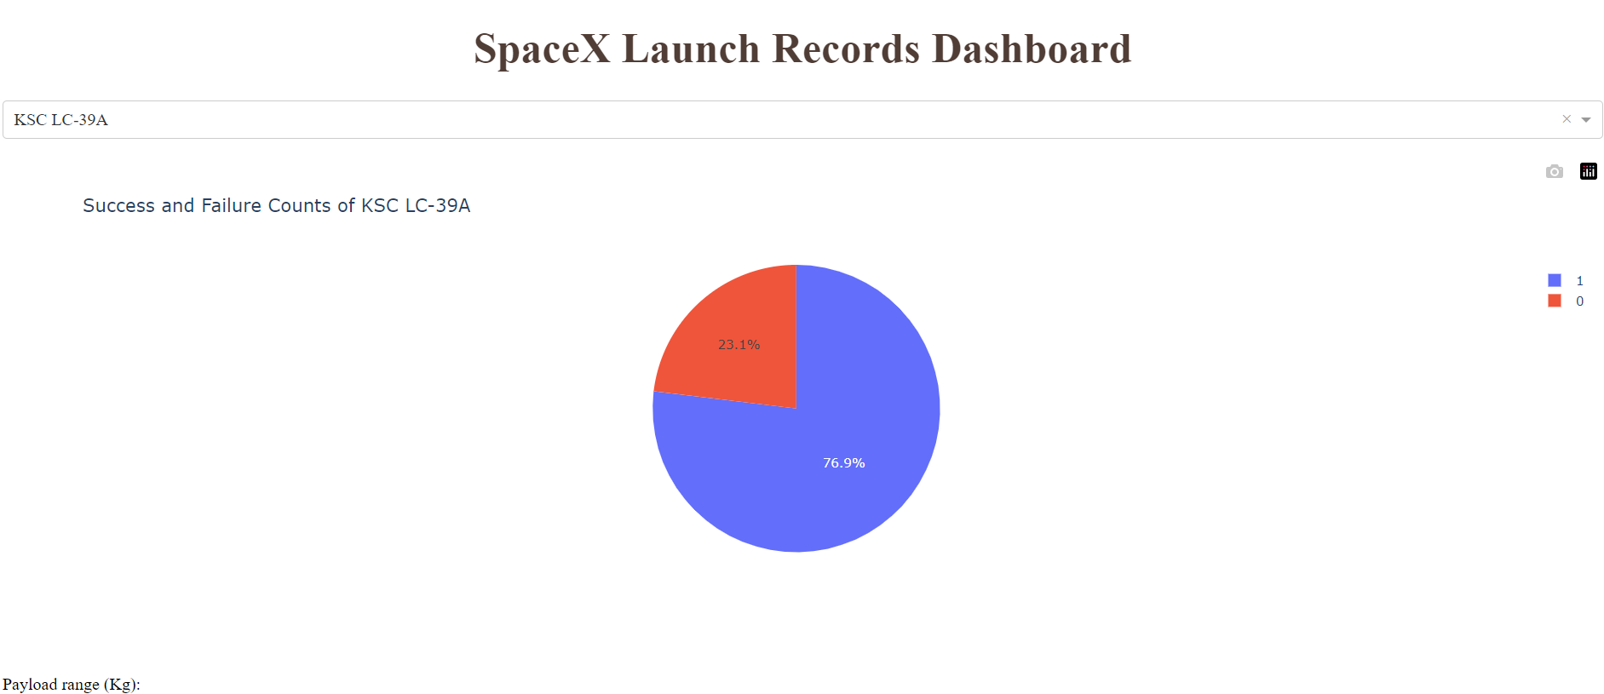
Insights Drawn From EDA
Plotly Pie Chart For The Launch Site with Highest Success Rate
• The pie chart indicates that KSC LC-39A has the highest success rate (76.9%).

Slide 40
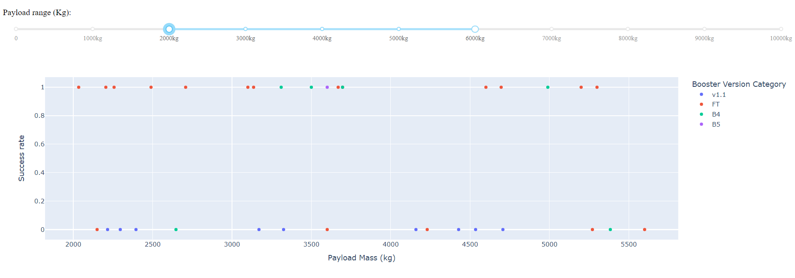
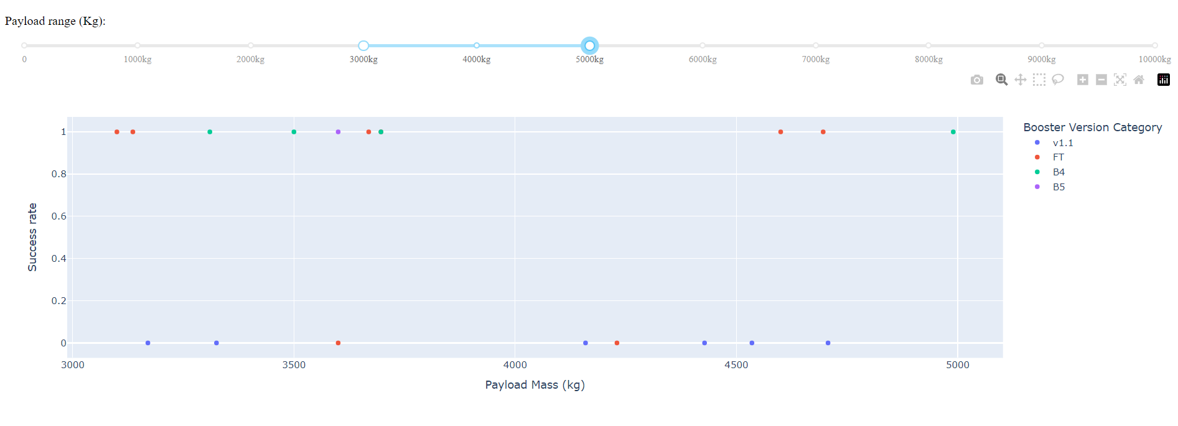
Insights Drawn From EDA
Plotly Scatter Plot For Payload Mass vs. Success Rate
• The scatter plot shows that payload mass ranging between 2000kg – 6000kg has the highest success rate.
• The scatter plot also shows that booster version FT has the highest success rate.

Slide 41
Predictive Analysis (Classification)
Phuc Thinh Nguyen
June 20th, 2024

Slide 42

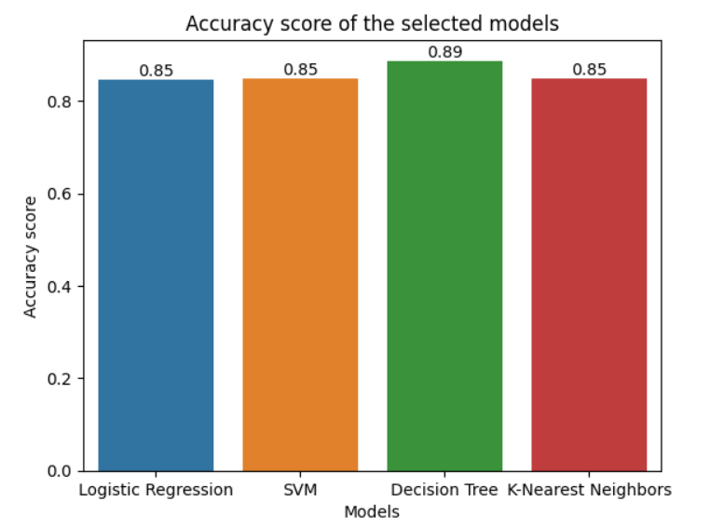
Predictive Analysis
Classification Accuracy
• The bar chart clearly indicates that decision tree is the best model to predict, with accuracy score of 0.89

Slide 43

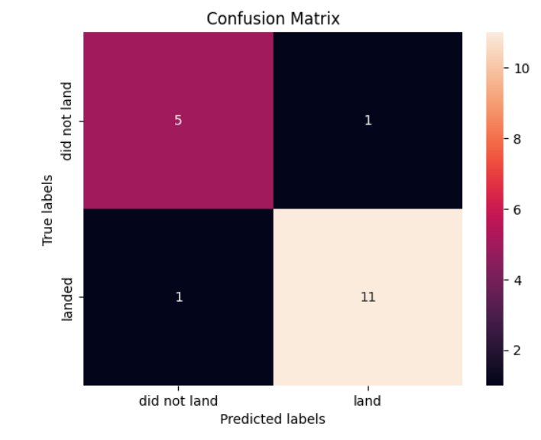
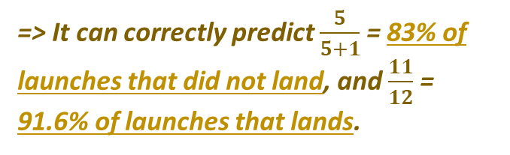
Predictive Analysis
Confusion Matrix
• The confusion matrix correctly predicts 5 launches that did not land.
• However, it misclassified 1 launches that did not land as the launch that lands.
• The confusion matrix correctly predicts 11 launches that land.
• However, it misclassified 1 launches that lands as the launch that did not land.
=> It can correctly predict $\frac{5}{5+1}$ = 83% of launches that did not land, and $\frac{11}{12}$ = 91.6% of launches that lands.

Slide 44

Predictive Analysis
Conclusion
KSC LC-39A is the recommend launch site for the next launch, since it has the highest success rate.
Low payload masses with ES-L1, SSO, and HEO orbits will have high success rate.
The success rate of the launches increases from 2013
until 2020.
All of the launches are in close proximity to the equator and extremely close proximity to the coastline.
Decision Tree is the best machine learning algorithm in
this classification scenario.

Slide 45
Thank you Coursera and IBM
Phuc Thinh Nguyen
June 20th, 2024
Sending love to everybody in the course <3

